Slide 1
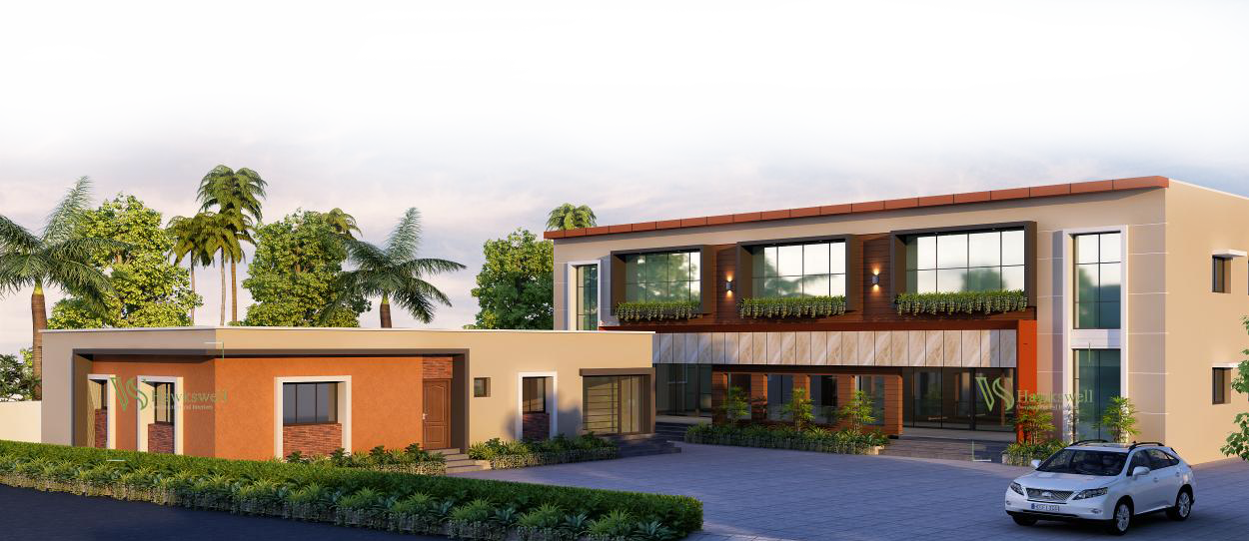

Slide 2
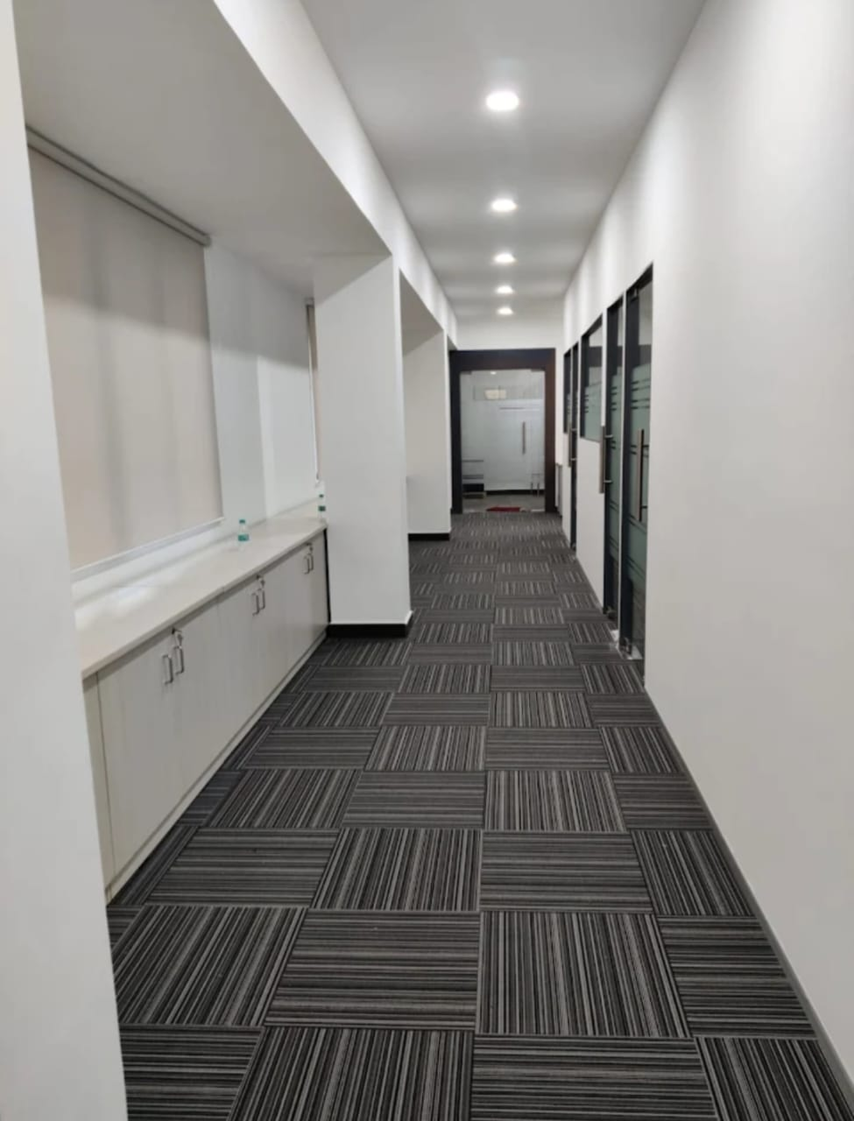
We Are
Started in 2020, VADIVEL RAMU & SURENDRAN KUMAR the chief of HAWKSWELL. Our team are 13+ years experienced in Interior and Exterior Turnkey projects, Constructions, Project Management and Project Consultancy.
Our passion is to improve the Ambience for our project space with best quality , blended with excellent Service, is the foundation for the successful business.

Slide 3
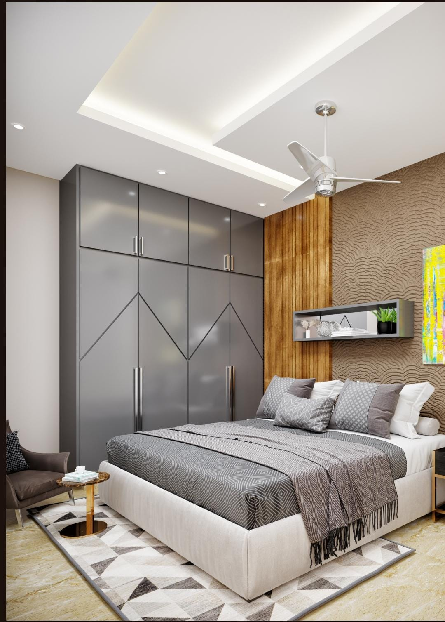
Our Work
Hawkswell is a equipped with the entire infrastructure. We are necessary to comfortably handle the largest and most complex projects, with a highly skilled workforce and team of professionals, We can deliver the results as desired by client. We have a team of Designers, Electrical & HVAC Consultant, Project managers, Site supervisors, Accounts and office admin.

Slide 4
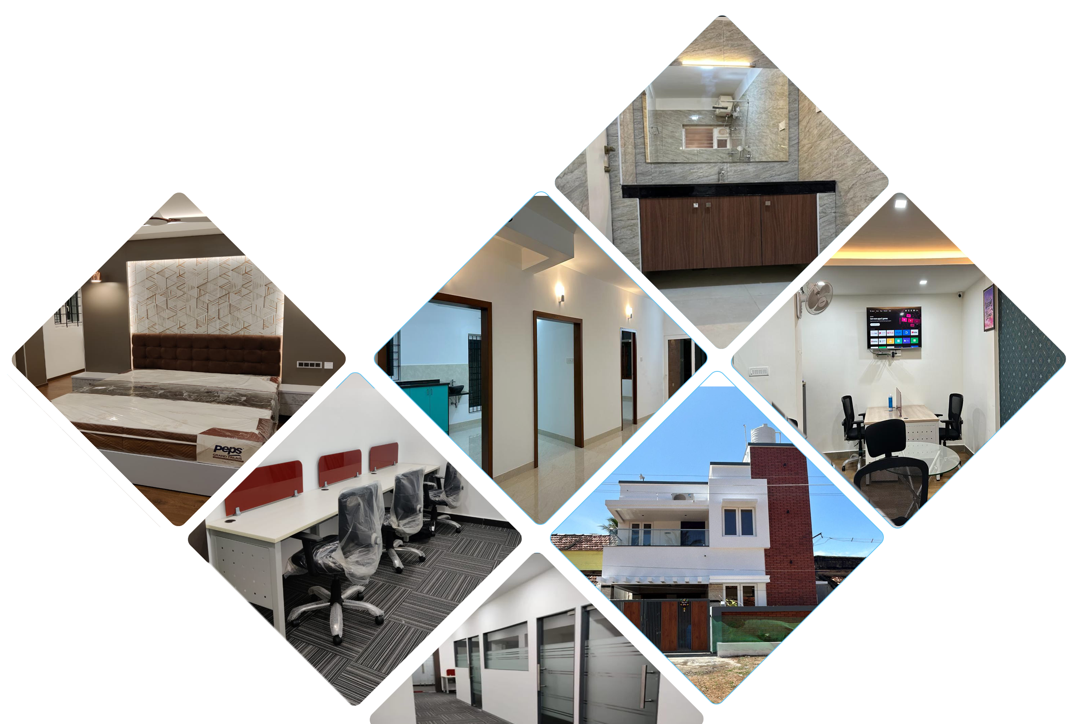
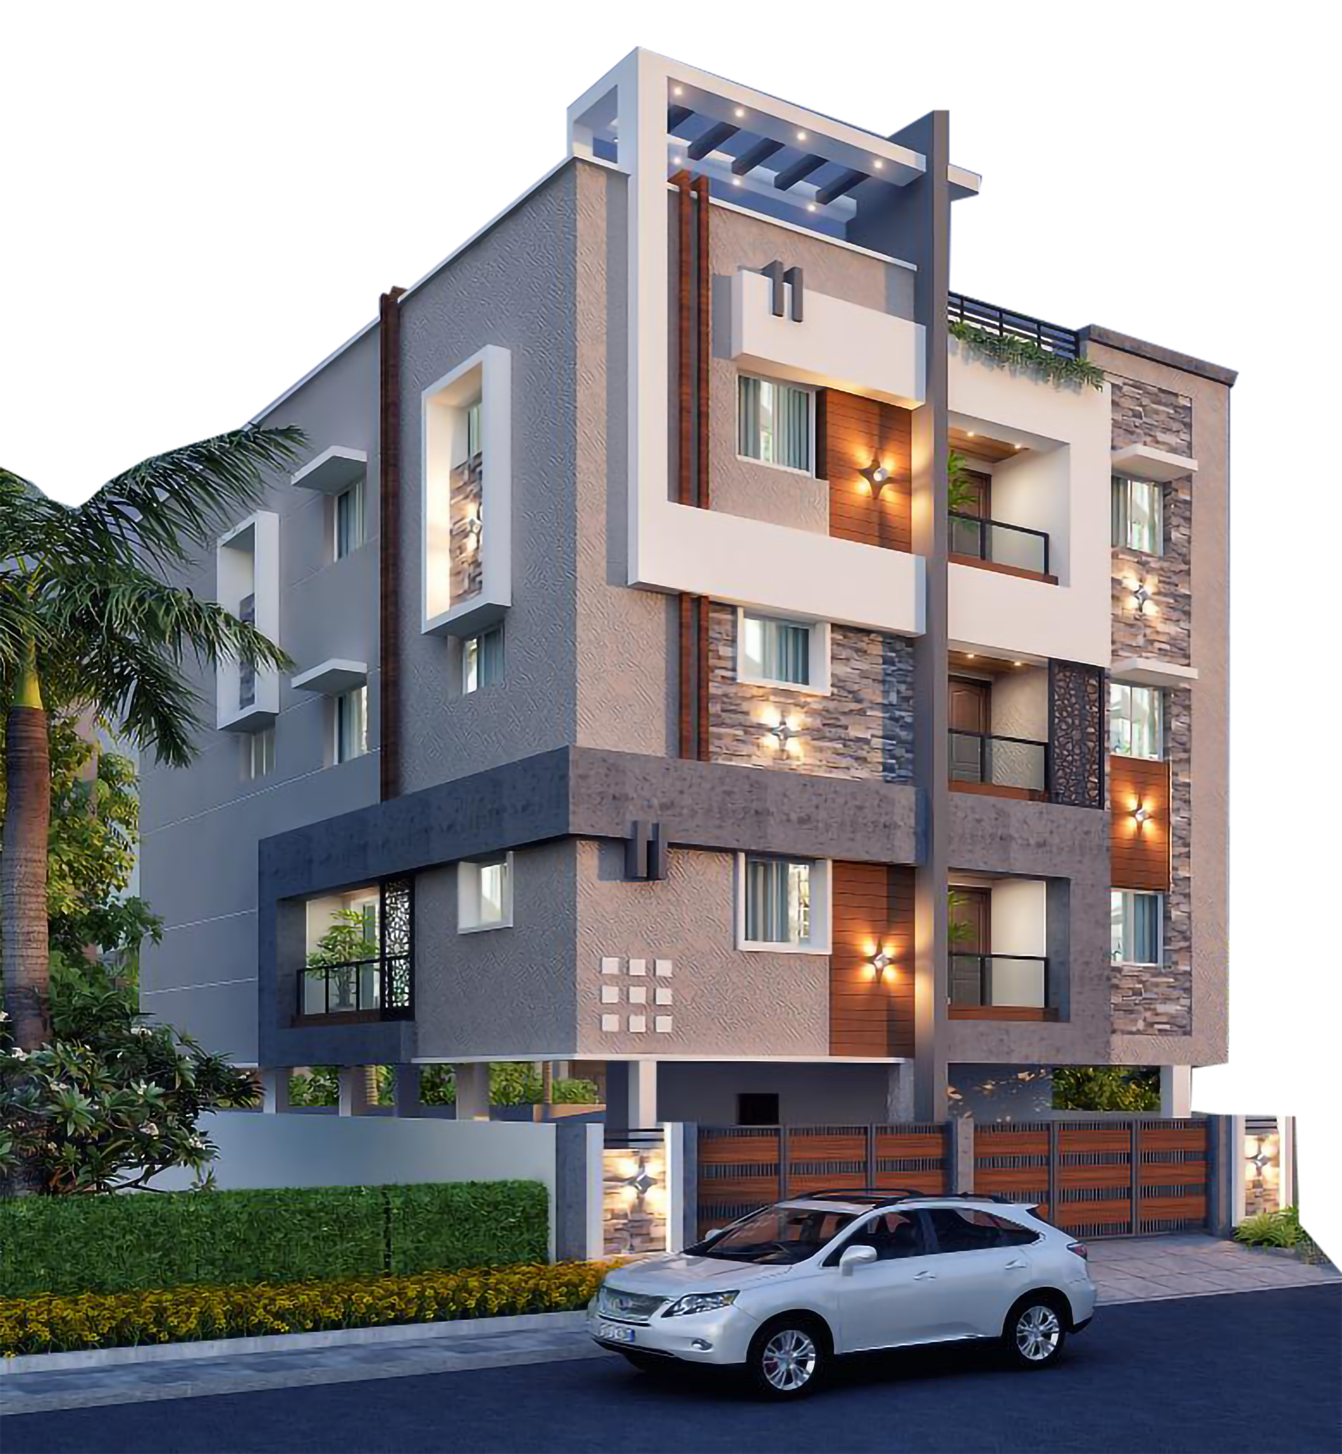
Our Recent Projects

Slide 5
Our Ongoing Projects

Slide 6
VADIVEL RAMU
#4-29 Second Floor, MIG,Pari Salai,
JJ NAGAR, Mugappair East, Chennai-600037
vel@hawkswell.in
Mob: 78128 88886
Off : 044 47688894

