Slide 1


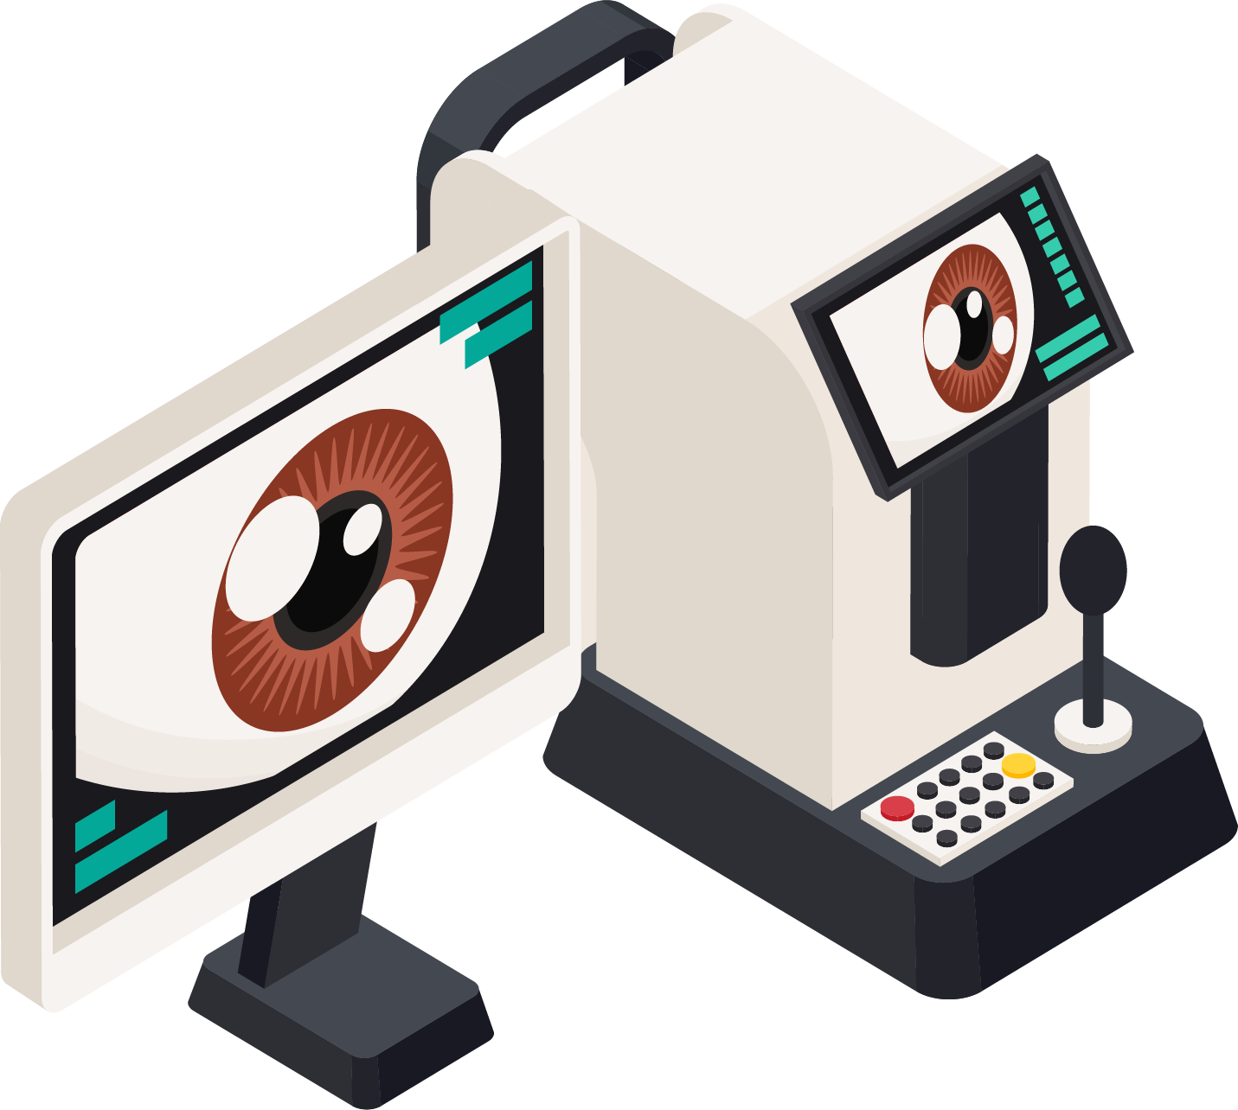
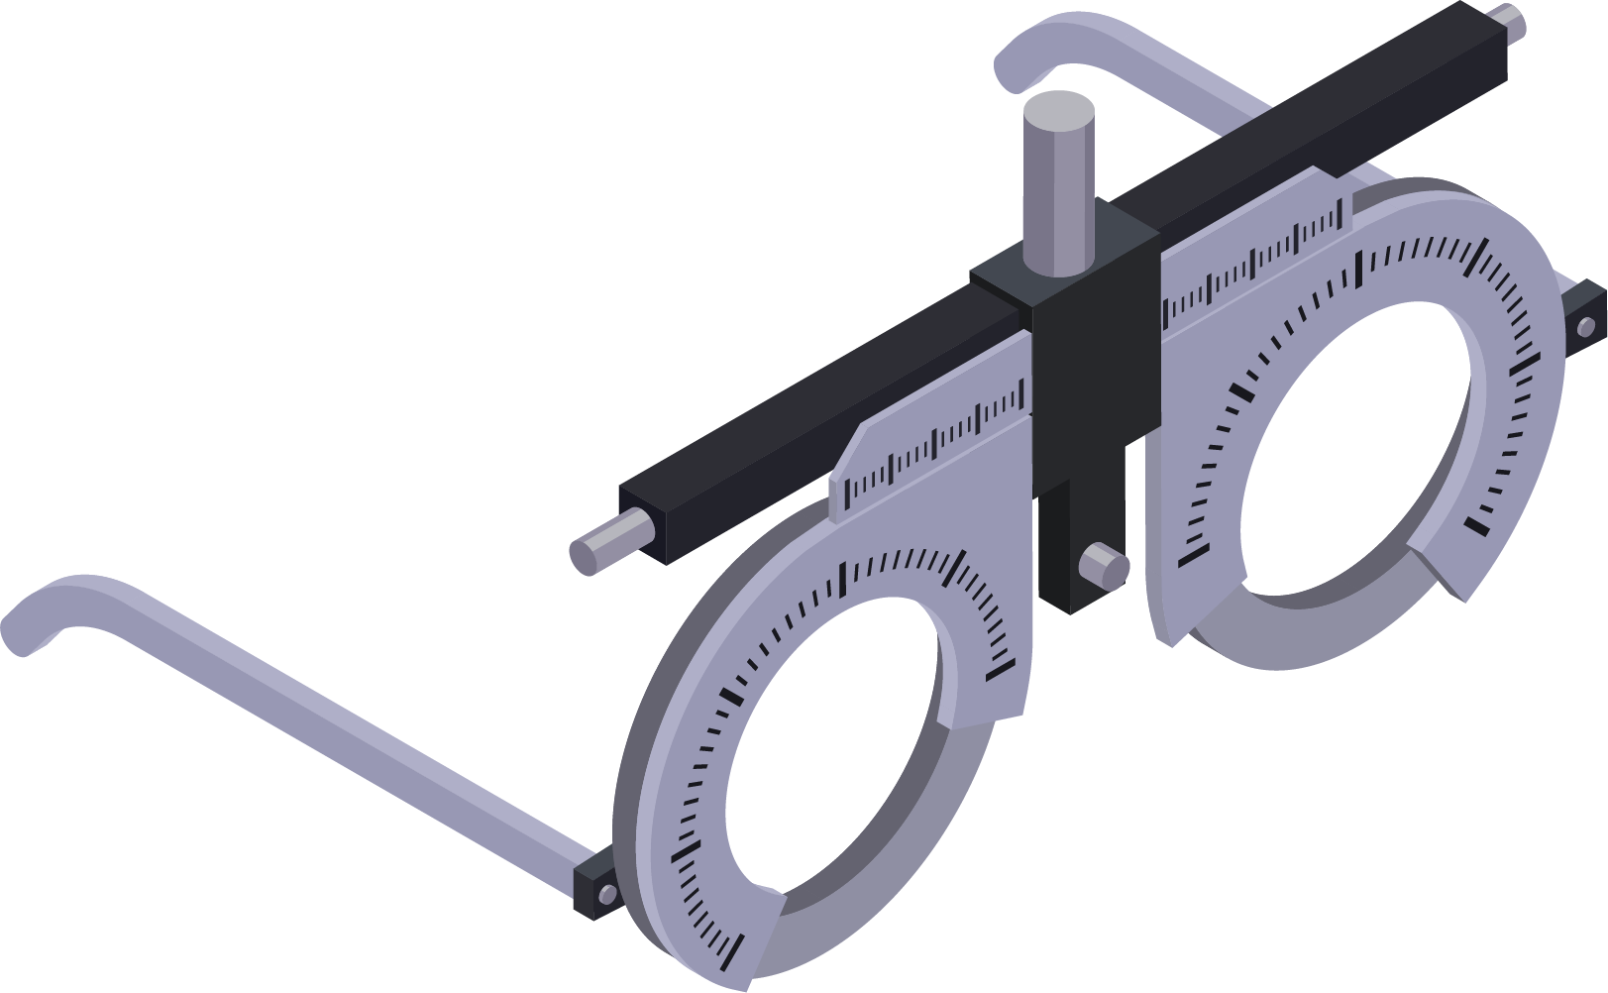
Dr Agarwal’s Health Care Limited
IPO Curtain Raiser

Slide 2

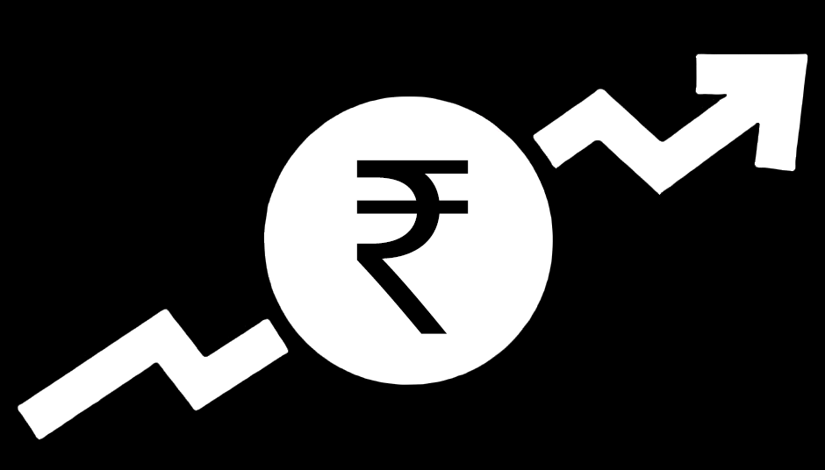


AGENDA
+
01
Health Care IPOs
02
Bankers
03
DRHP and Listing Timeline
04
Price on listing
05
Institutional Investors

Slide 3






Health Care IPOs
INR.3271 Cr
November 2022
Kotak Mahindra Capital
INR.4466 Cr
December 2015
Kotak Mahindra Capital
INR.1111 Cr
May 2022
Kotak Mahindra Capital
INR.429 Cr
January 2016
Axis Capital
INR.674 Cr
April 2019
JM Financial
INR.1189 Cr
June 2021
Kotak Mahindra Capital

Slide 4





Health Care IPOs
INR.1000 Cr
December 2021
Axis Capital
INR.1895 Cr
September 2021
ICICI Securities
INR.980 Cr
February 2018
Kotak Mahindra Capital
INR.649 Cr
March 2016
Kotak Mahindra Capital
INR.6695 Cr
November 2020
Kotak Mahindra Capital

Slide 5
Bankers
Total
9
5
4
3
2
2
2
1
1

Slide 6
Bankers

Slide 7
DRHP
Average
146 Days

Slide 8
Price on listing

Slide 9
Price on listing
Amounts in Rs. Crores

Slide 10



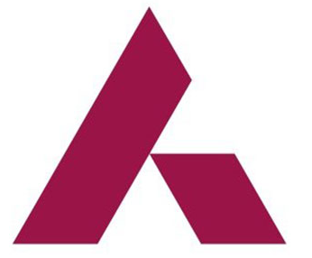



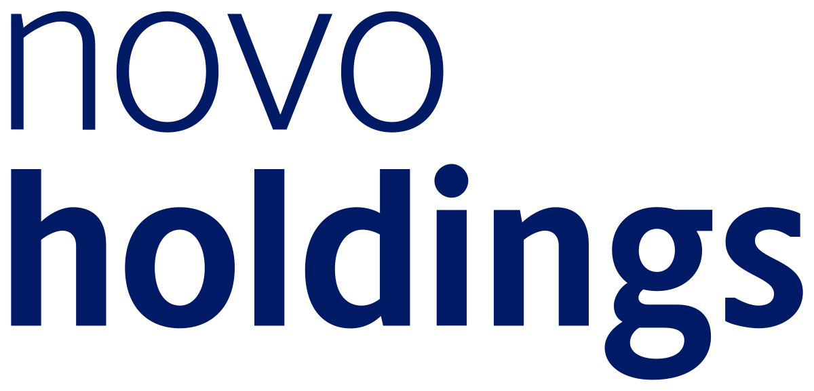
Institutional Investors
AXIS
NIPPON
HDFC
SBI
MOTILAL OSWAL
AMANSA HOLDINGS
NOVO HOLDINGS
TATA

Slide 11








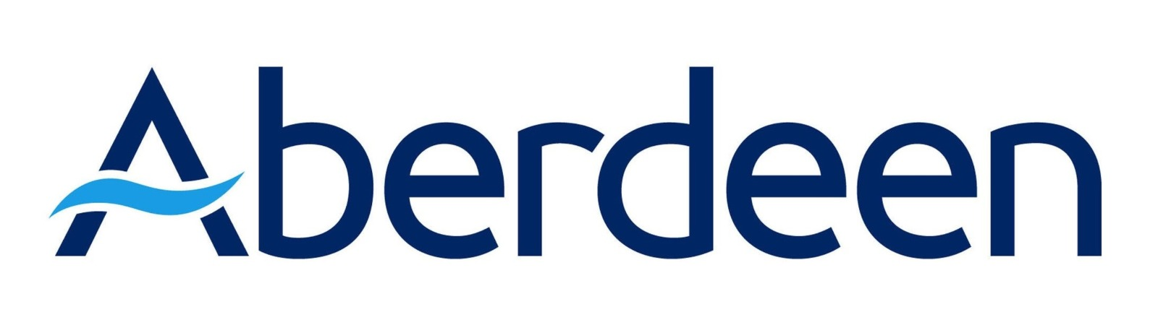
Institutional Investors
DSP
POLAR CAPITAL FUNDS
ICICI
UTI
ADITYA BIRLA
MIRAE
RJ CORP
NOMURA
Other Investors
ABERDEEN
Wasatch
Fundsmith
Grandeur Peak Global
Sundaram Mutual Fund
Fidelity Funds
Abu Dhabi Investment Authority
Reliance Capital

Slide 12
Thank you
Corporate Affairs Team
Dr Agarwal’s Eye Hospital

